Slide 1
Chapter 1 The Facts of Life: Chemistry is the Logic of Biological Phenomena

Slide 2



Slide 3
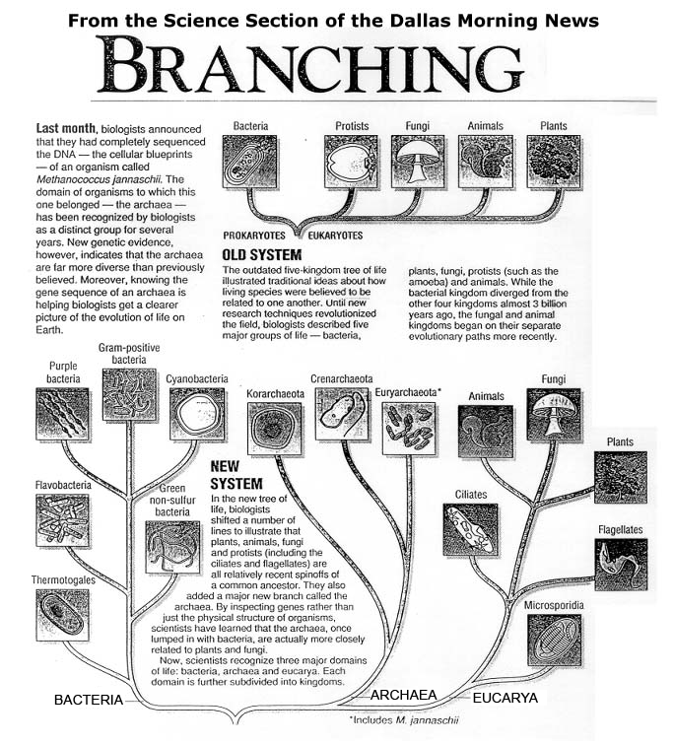

Slide 4
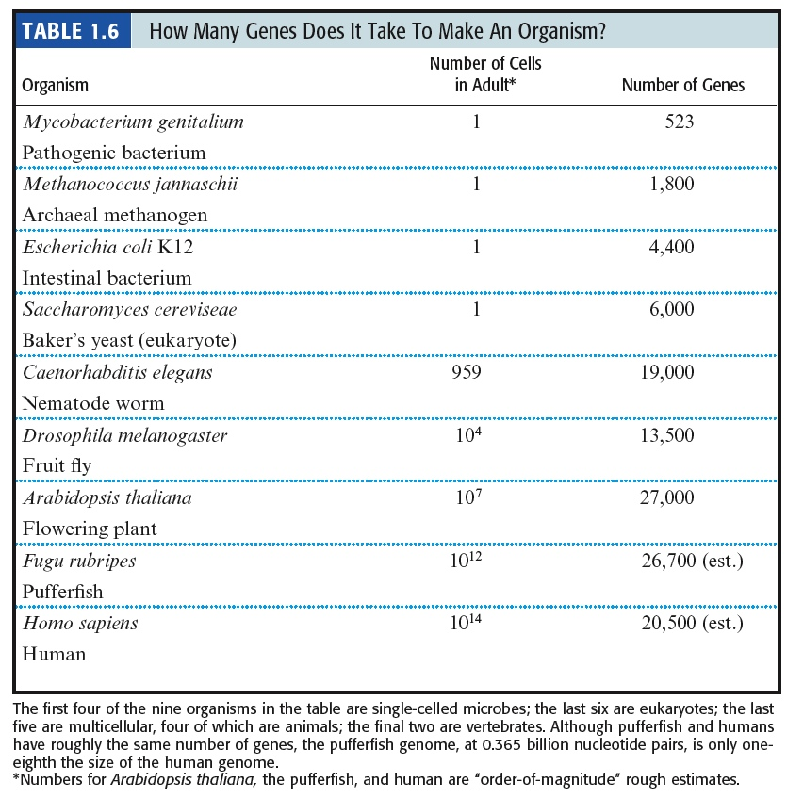
How Many Genes Does a Cell Need?
(Mycoplasma genitalium)

Slide 5
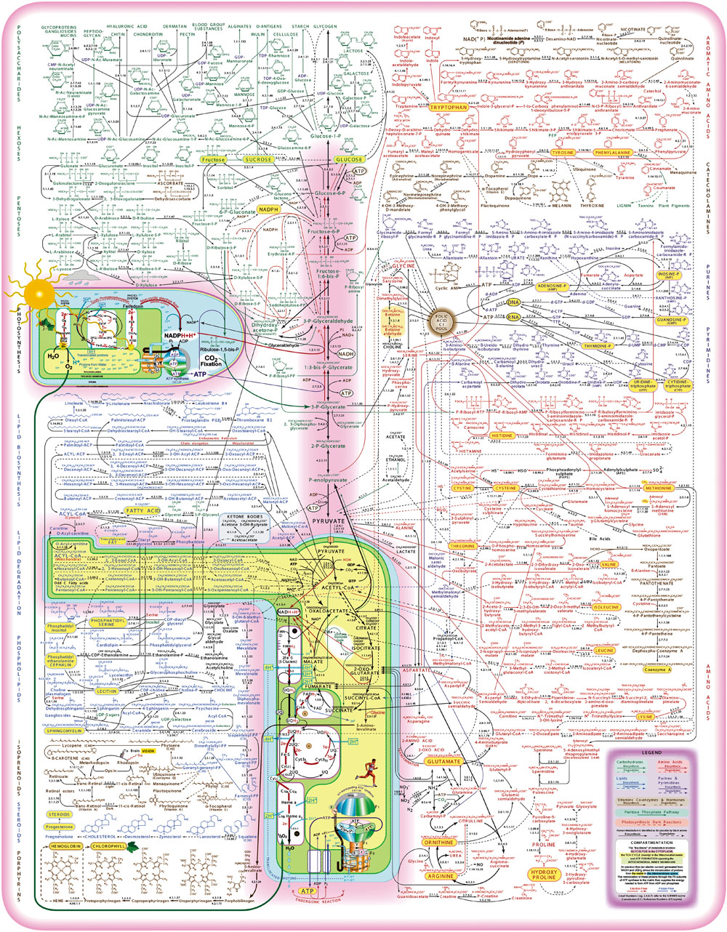
Figure 17.2 A metabolic map, indicating the reactions of intermediary metabolism and the enzymes that catalyze them. More than 500 different chemical intermediates, or metabolites, and a greater number of enzymes are represented here.
For a detailed look go to:
http://www.sigmaaldrich.com/etc/medialib/docs/Sigma-Aldrich/General_Information/metabolicpathways_updated_02_07.Par.0001.File.tmp/metabolic_pathways_poster.pdf

Slide 6
Outline
Three Domains of Life – Biochemistry in Common
Chemical Elements of Life
Functional Groups of Biomolecules
Biopolymers
Weak Forces
Bond Energies

Slide 7
1.2 What Kinds of Molecules are Biomolecules?
H, O, C and N make up 99+% of atoms in the human body
ELEMENT | PERCENTAGE
Hydrogen | 63
Oxygen | 25.5
Carbon | 9.5
Nitrogen | 1.4

Slide 8
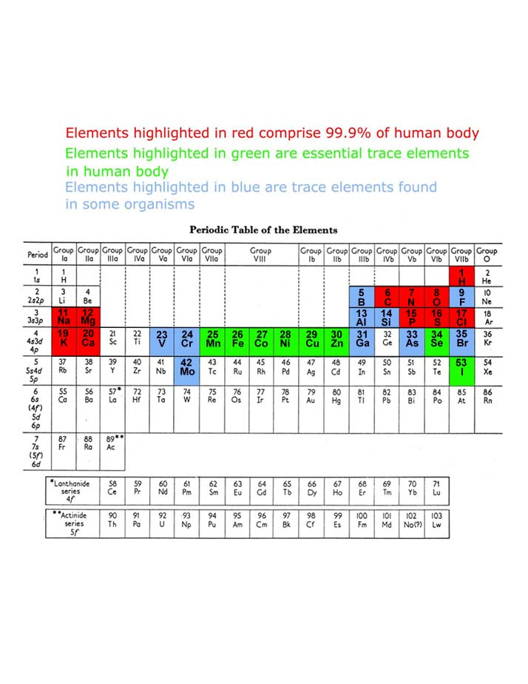

Slide 9
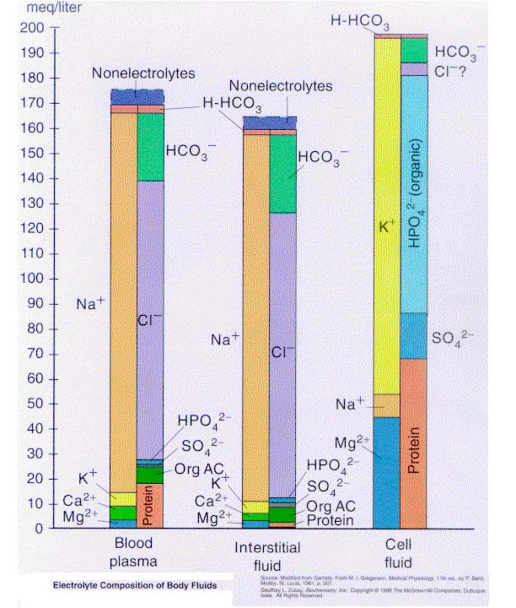
What are the major ions of life?

Slide 10
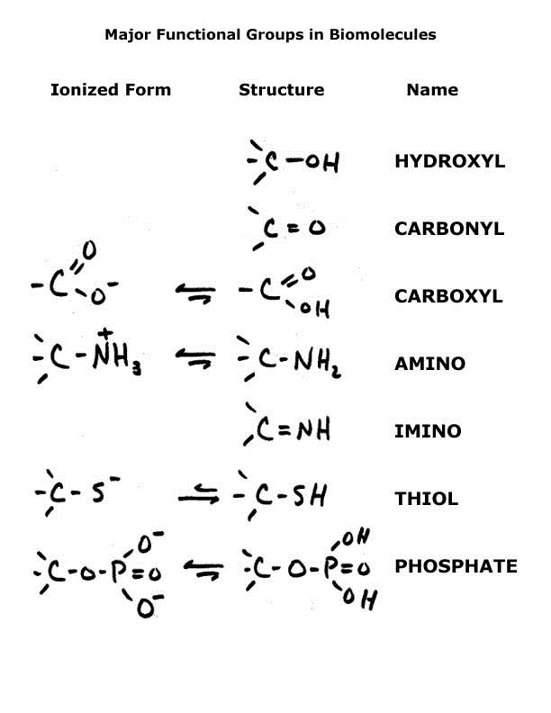

Slide 11
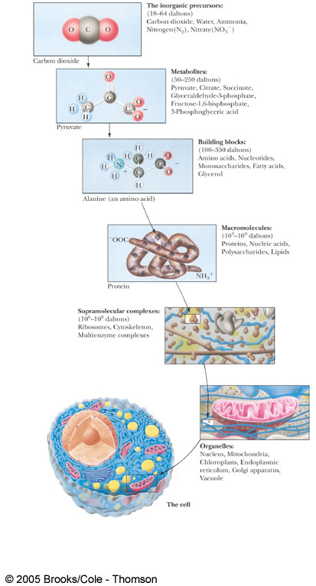
Figure 1.8 Molecular organization in the cell is a hierarchy.

Slide 12
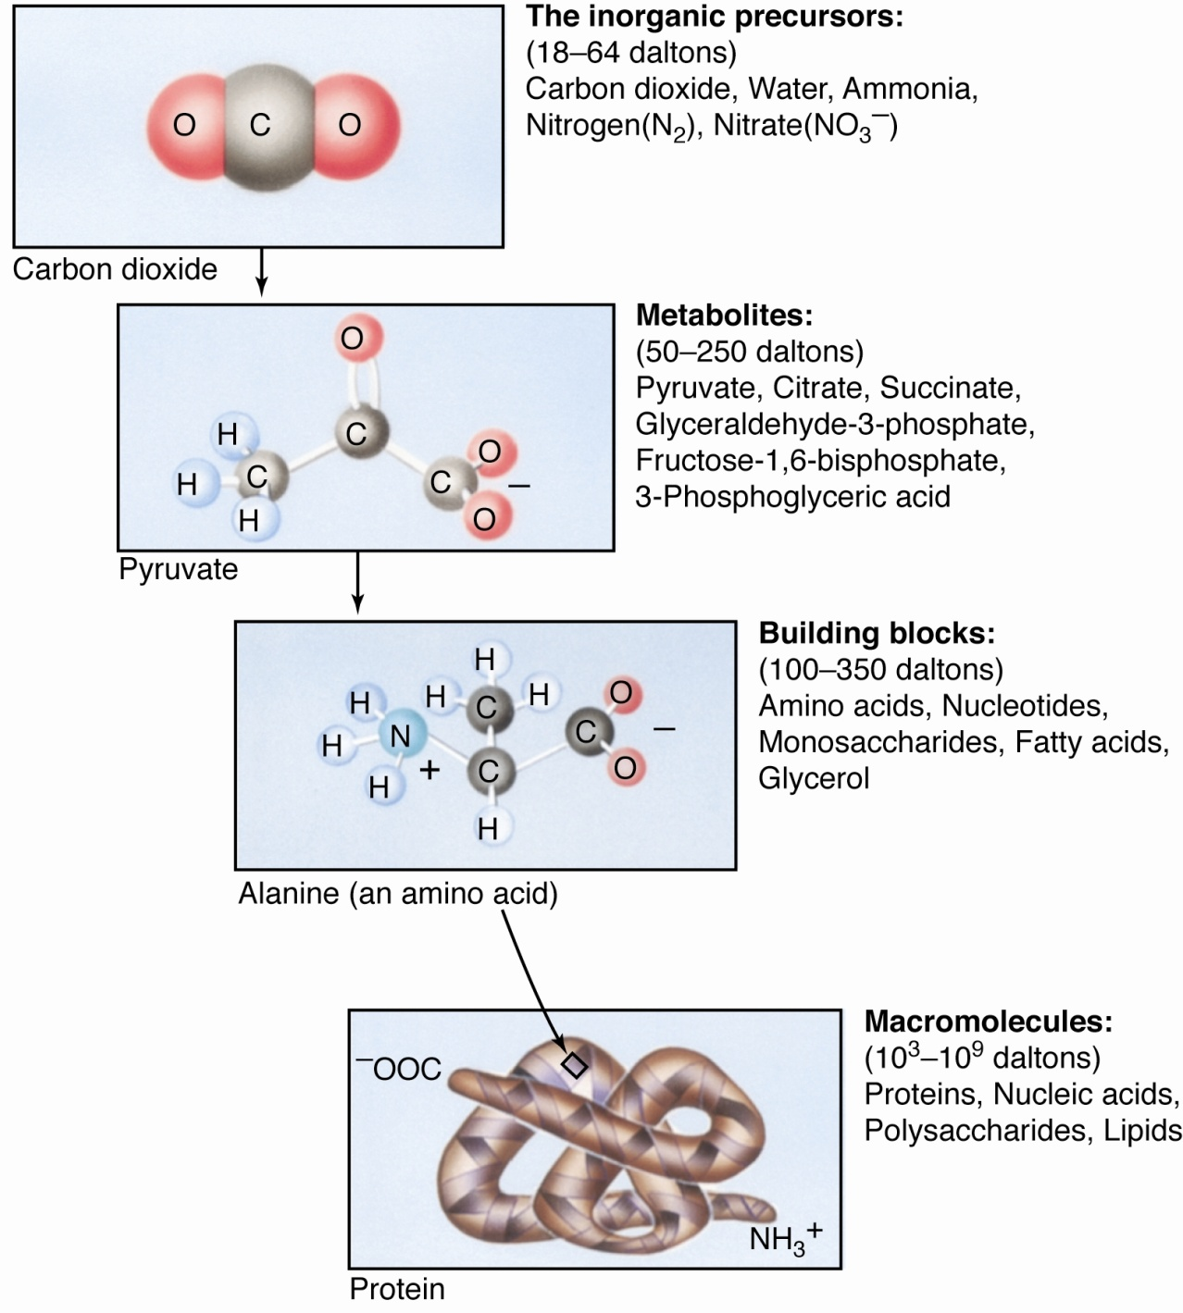

Slide 13
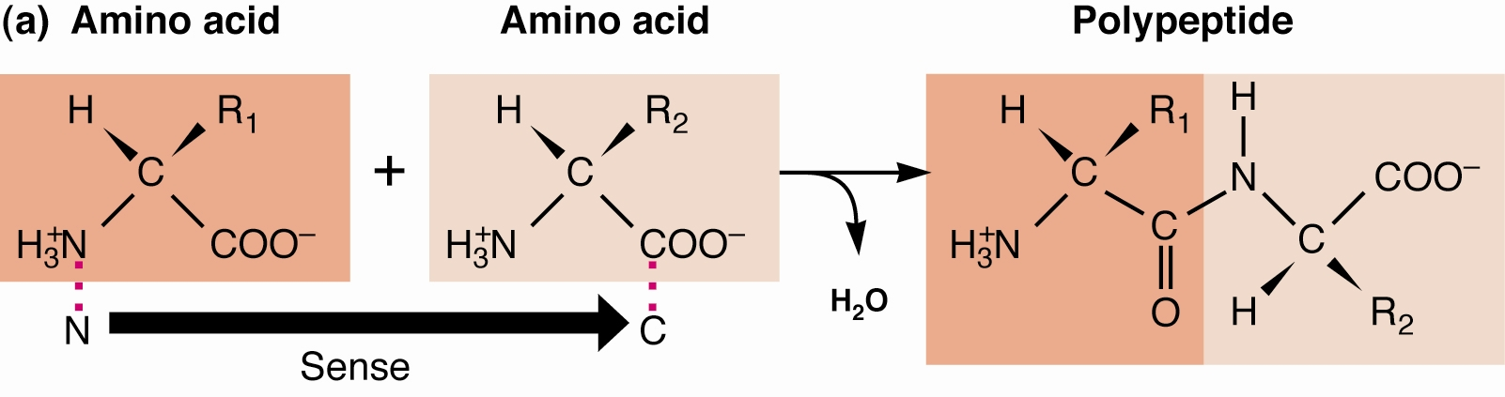
Fig.1.9 Biopolymers (aka. macromolecules)
Amino acids build proteins

Slide 14
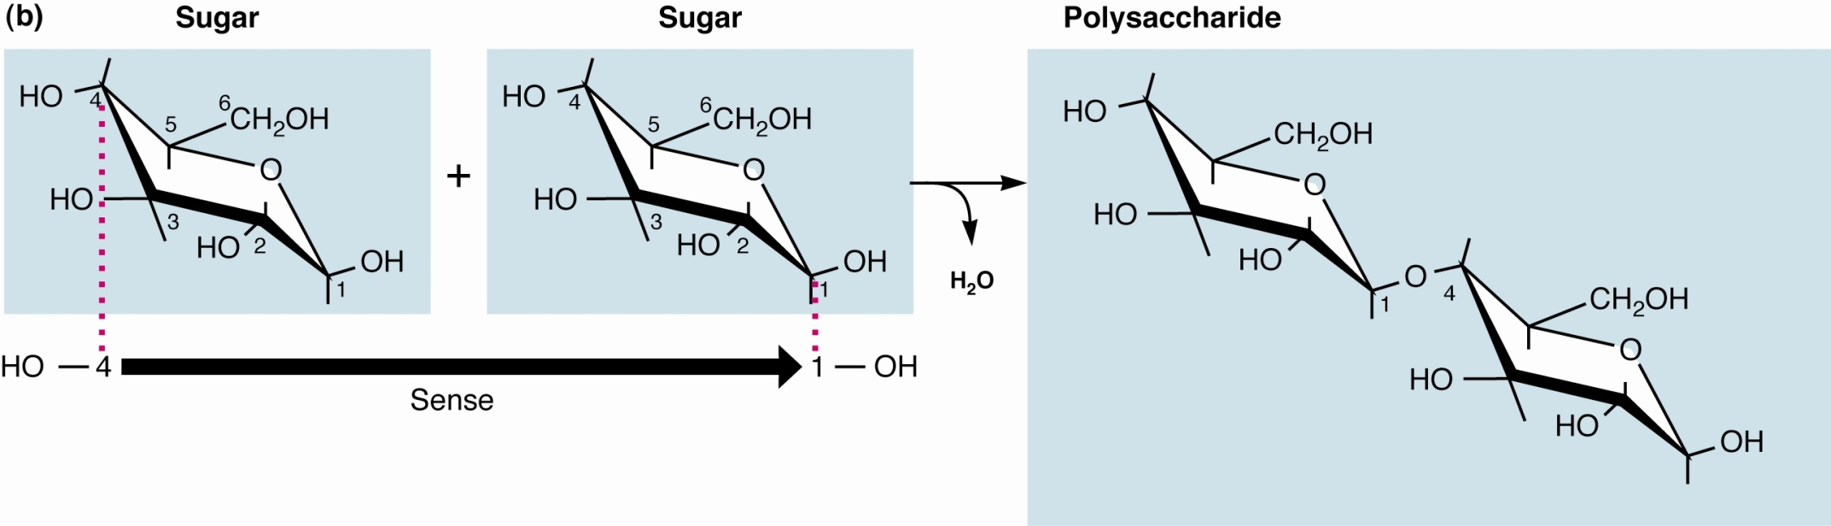
Fig.1.9 Biopolymers (aka. macromolecules)
Polysaccharides are built by joining sugars together

Slide 15
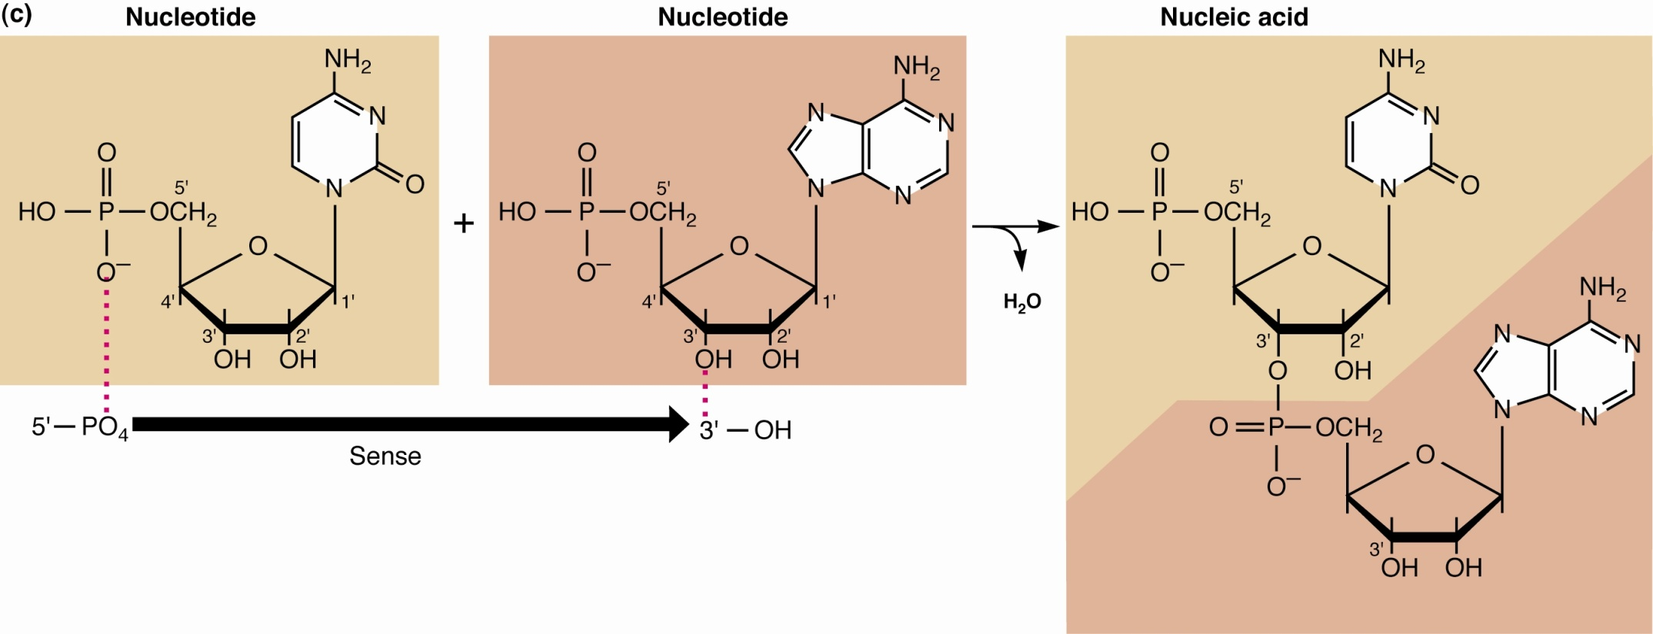
Fig.1.9 Biopolymers (aka. macromolecules)
Nucleic acids are polymers of nucleotides

Slide 16
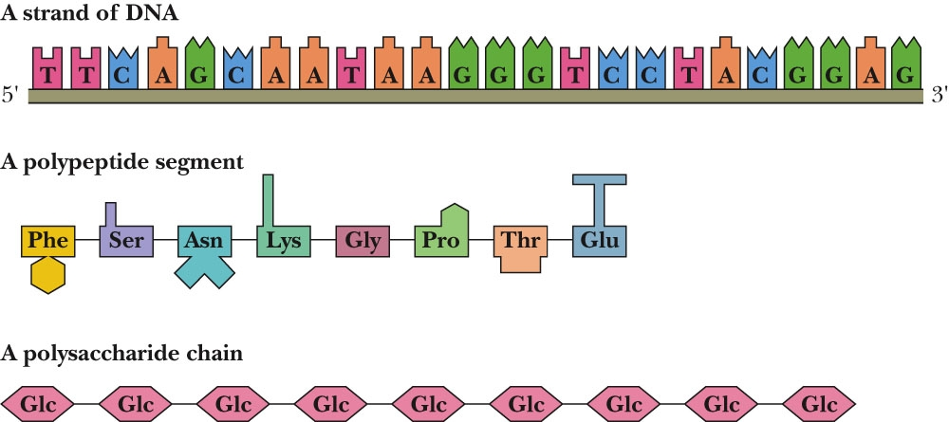
The Major Biopolymers

Slide 17
Sec. 1.4 Properties of Biomolecules Reflect Their Fitness to the Living Condition
Macromolecules and their building blocks have a “sense” or directionality
Macromolecules are informational
Biomolecules have characteristic three-dimensional architecture

Slide 18
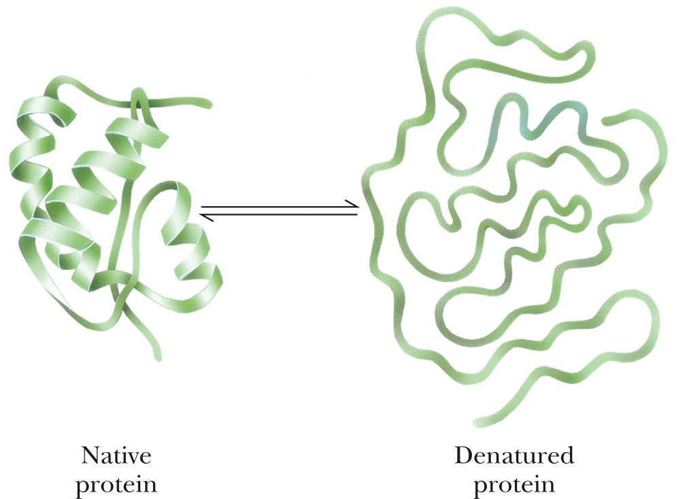
Figure 1.17 Denaturation and renaturation of the intricate structure of a protein.

Slide 19
Weak Forces
Maintain Biological Structure
Determine Biomolecular Interactions

Slide 20
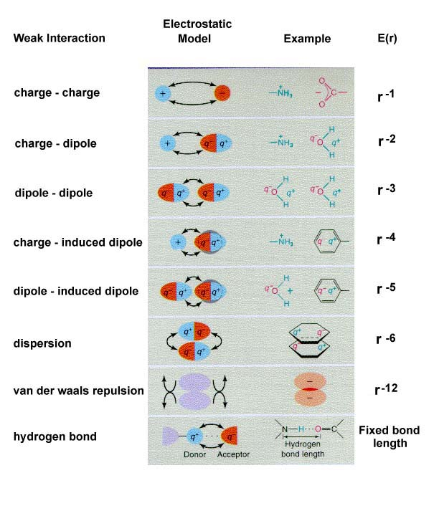

Slide 21
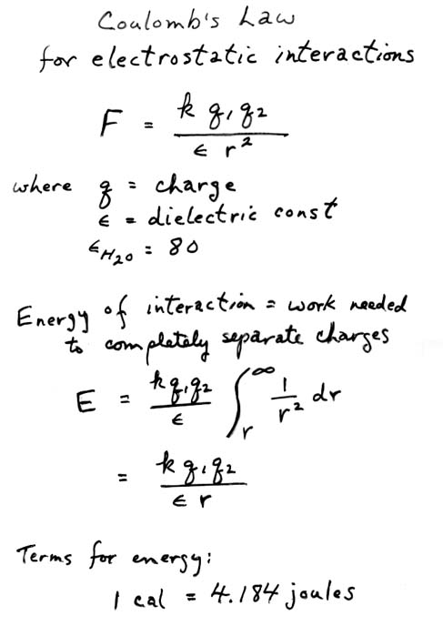

Slide 22
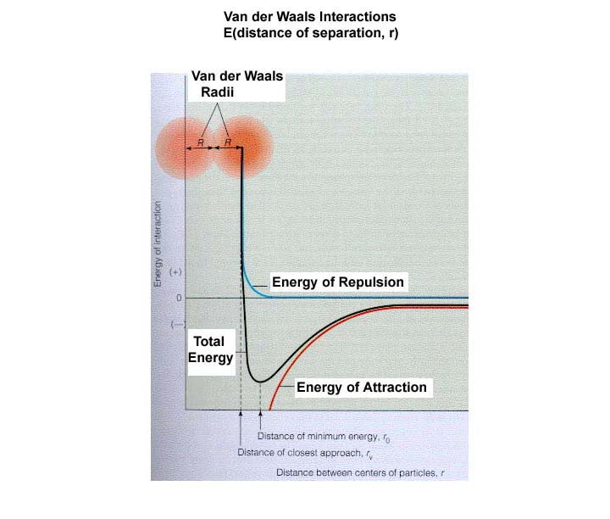

Slide 23
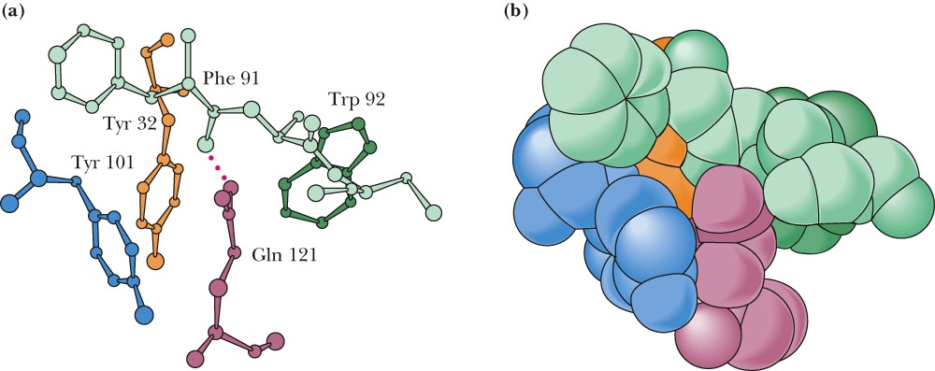
Fig. 1.12 Van der Waals Forces Are Important to Biomolecular Interactions
Figure 1.12 Van der Waals packing is enhanced in molecules that are structurally complementary. Gln¹²¹ represents a surface protuberance on the protein lysozyme. This protuberance fits nicely within a pocket (formed by Tyr¹⁰¹, Tyr³², Phe⁹¹, and Trp⁹²) in the antigen-binding domain of an antibody raised against lysozyme. (See also Figure 1.16.) (a) A ball-and-stick model. (b) A space-filling representation. (From Science 233:751 (1986), figure 5.)

Slide 24
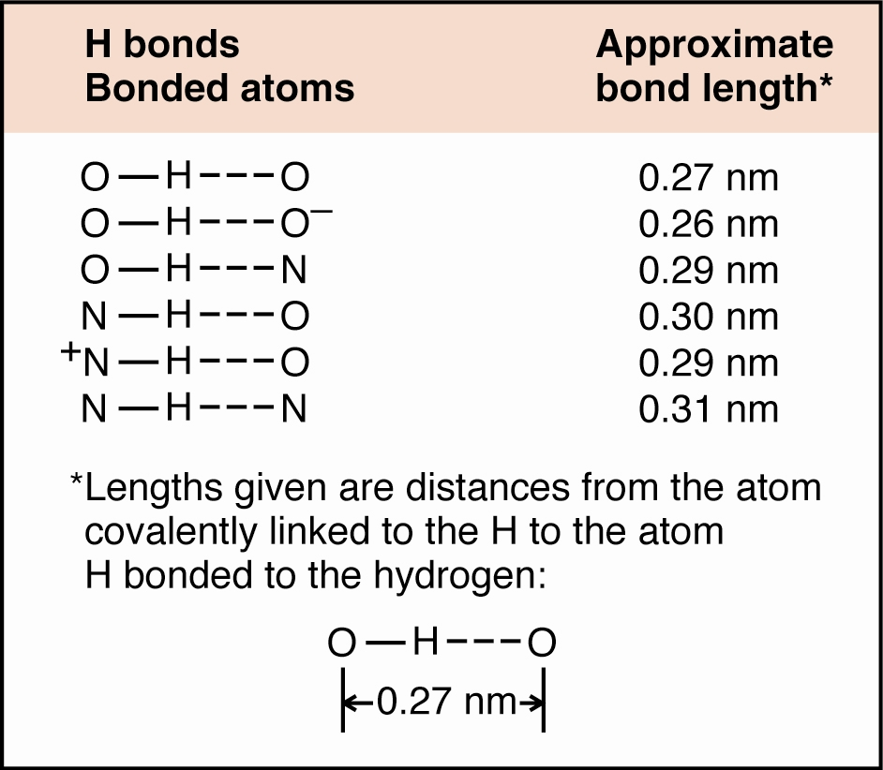
Fig. 1.14 Some biologically important H bonds

Slide 25
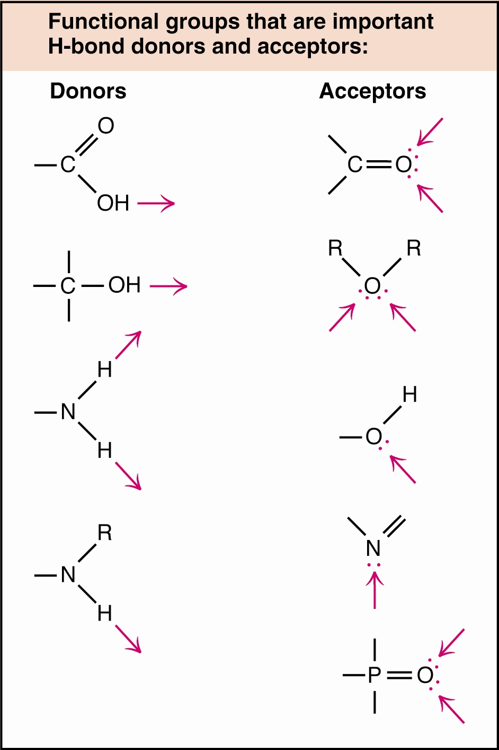
Figure 1.14 Some of the biologically important functional groups that serve as H bond donors and acceptors.

Slide 26
Fig. 1.14 Some biologically important H bonds

Slide 27
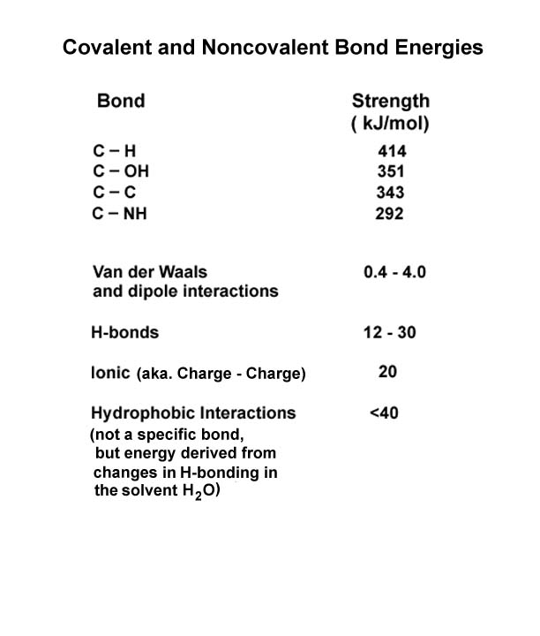

Slide 28
Two Important Points About Weak Forces
Biomolecular Recognition is Mediated by Weak Chemical Forces
Weak Forces Restrict Organisms to a Narrow Range of Environmental Conditions

